Slide 1
Module 10 – Transaction Management & Concurrency Control
Ensuring safe and reliable data updates in multi-user databases.

Slide 2
Learning Outcomes
By the end of this module, you will be able to:
Define what a database transaction is.
Explain the purpose of transaction management.
Describe the ACID properties of transactions.
Identify common concurrency problems.
Explain locking and isolation mechanisms for concurrency control.
Discuss how transaction logs ensure atomicity and durability.

Slide 3
Lecture 1 – Transactions, Concurrency & ACID

Slide 4
Why Transaction Management?
Real-world actions like buying a product or registering for a course involve many database changes.
We need a way to ensure:
✅ all changes succeed together
❌ or none take effect
Otherwise, we risk inconsistent data.

Slide 5
Example: Course Registration
Check seat availability
Insert a new ENROLLMENT record
Update COURSE_OFFERING.Seats_Remaining
Record a payment
→ All must succeed or all must roll back.

Slide 6
What Is a Transaction?
A transaction is a single or group of SQL operations treated as one logical unit of work.
Examples:
Insert new customer, invoice, and invoice lines
Transfer money between two accounts
Register a student and update seat count

Slide 7
What is a Transaction?
Real-world Transactions
Database Transactions
Buying a product
Registering for a course
Making a deposit into a checking account

Slide 8

What is a Transaction?
Real-world Transactions
Database Transactions
Buying a product
Registering for a course
Making a deposit into a checking account
How do we represent these real-world transactions in a database?

Slide 9
Two Core Requirements
Concurrent Access: many users accessing the same data simultaneously.
Resilience to Failures: system crashes or power loss shouldn’t corrupt data.

Slide 10
Concurrent Database Access
DBMS
Data

Slide 11
Concurrent Database Access
More Software
DBMS
Data

Slide 12
Concurrent Database Access
Even More Software
More Software
DBMS
Data

Slide 13
Concurrent Database Access
Even More Software
Select
Update
Create Table
Drop Index
Delete
...
More Software
DBMS
Data

Slide 14
Concurrent Database Access
Even More Software
Select
Update
Create Table
Drop Index
Delete
...
The important point here is that the multiple users or applications that issue commands against the DB, would do so at the same time.
More Software
DBMS
Data

Slide 15
Concurrent Database Access
Even More Software
Select
Update
Create Table
Drop Index
Delete
...
The important point here is that the multiple users or applications that issue commands against the DB, would do so at the same time.
More Software
DBMS
This concurrent access can cause some difficulties
Data

Slide 16
The Concurrency Problem
When multiple users issue SQL commands at the same time:
Their actions can interfere with each other.
The database might enter an inconsistent state.

Slide 17
Attribute-Level Inconsistency
UPDATE CUSTOMER
SET CUS_BALANCE = CUS_BALANCE + 100
WHERE CUS_CODE = ‘12345’;
S1
Concurrent with ...
UPDATE CUSTOMER
SET CUS_BALANCE = CUS_BALANCE + 250
WHERE CUS_CODE = ‘12345’;
S2

Slide 18
Attribute-Level Inconsistency
UPDATE CUSTOMER
SET CUS_BALANCE = CUS_BALANCE + 100
WHERE CUS_CODE = ‘12345’;
Both S1 and S2 need to get, modify and put back the value of CUS_BALANCE
S1
Concurrent with ...
UPDATE CUSTOMER
SET CUS_BALANCE = CUS_BALANCE + 250
WHERE CUS_CODE = ‘12345’;
S2

Slide 19
Attribute-Level Inconsistency
UPDATE CUSTOMER
SET CUS_BALANCE = CUS_BALANCE + 100
WHERE CUS_CODE = ‘12345’;
get, modify, put
400 + 100 + 250 = 750 ✅
S1
Ideally S1 completes after S2 (or vice versa)
Concurrent with ...
UPDATE CUSTOMER
SET CUS_BALANCE = CUS_BALANCE + 250
WHERE CUS_CODE = ‘12345’;
S2

Slide 20
Attribute-Level Inconsistency
UPDATE CUSTOMER
SET CUS_BALANCE = CUS_BALANCE + 100
WHERE CUS_CODE = ‘12345’;
get, modify, put
400 + 100 + 250 = 750 ✅
100 = 500 ❌
250 = 650 ❌
S1
possible that the get, modify and put of S1 & S2 are interweaved such that one update gets lost!
Concurrent with ...
UPDATE CUSTOMER
SET CUS_BALANCE = CUS_BALANCE + 250
WHERE CUS_CODE = ‘12345’;
S2

Slide 21
Tuple-Level Inconsistency
UPDATE PRODUCT
SET P_QOH = P_QOH - 5
WHERE P_CODE = ‘123’;
Both S1 and S2 need to get, modify and put back the same row
S1
Concurrent with ...
123
UPDATE PRODUCT
SET P_REORDER = 1
WHERE P_CODE = ‘123’;
S2

Slide 22
Tuple-Level Inconsistency
UPDATE PRODUCT
SET P_QOH = P_QOH - 5
WHERE P_CODE = ‘123’;
get, modify, put
S1
Ideally S1 completes after S2 (or vice versa) so both changes are made
123
Concurrent with ...
UPDATE PRODUCT
SET P_REORDER = 1
WHERE P_CODE = ‘123’;
S2

Slide 23
Tuple-Level Inconsistency
UPDATE PRODUCT
SET P_QOH = P_QOH - 5
WHERE P_CODE = ‘123’;
get, modify, put
S1
Without transaction management, possible that one change is lost
123
Concurrent with ...
UPDATE PRODUCT
SET P_REORDER = 1
WHERE P_CODE = ‘123’;
S2

Slide 24
Table-Level Inconsistency
APPLY
UPDATE APPLY
SET DECISION = ‘Y’
WHERE S_ID IN (
SELECT S_ID FROM STUDENT WHERE GPA > 3.9)
S1
Concurrent with ...
STUDENT
UPDATE STUDENT
SET GPA = GPA * 1.1
WHERE HS_SIZE > 2500;
S2

Slide 25
Table-Level Inconsistency
APPLY
UPDATE APPLY
SET DECISION = ‘Y’
WHERE S_ID IN (
SELECT S_ID FROM STUDENT WHERE GPA > 3.9)
S1
S1 needs to query the STUDENT table before updating the APPLY table
Concurrent with ...
STUDENT
UPDATE STUDENT
SET GPA = GPA * 1.1
WHERE HS_SIZE > 2500;
S2

Slide 26
Table-Level Inconsistency
APPLY
UPDATE APPLY
SET DECISION = ‘Y’
WHERE S_ID IN (
SELECT S_ID FROM STUDENT WHERE GPA > 3.9)
S1
At the same time, the STUDENT table is being updated by S2!
Concurrent with ...
STUDENT
UPDATE STUDENT
SET GPA = GPA * 1.1
WHERE HS_SIZE > 2500;
S2

Slide 27
Multi-Statement Inconsistency
INSERT INTO ARCHIVE
SELECT * FROM APPLY WHERE DECISION = ‘N’;
DELETE FROM APPLY WHERE DECISION = ‘N’;
C1
APPLY
ARCHIVE
Concurrent with ...
SELECT COUNT(*) FROM APPLY;
SELECT COUNT(*) FROM ARCHIVE;
C2

Slide 28
Multi-Statement Inconsistency
INSERT INTO ARCHIVE
SELECT * FROM APPLY WHERE DECISION = ‘N’;
DELETE FROM APPLY WHERE DECISION = ‘N’;
C1
APPLY
ARCHIVE
C1 needs to move records from APPLY to ARCHIVE and then delete some records from APPLY
❌
Concurrent with ...
❌
❌
SELECT COUNT(*) FROM APPLY;
SELECT COUNT(*) FROM ARCHIVE;
C2

Slide 29
Multi-Statement Inconsistency
INSERT INTO ARCHIVE
SELECT * FROM APPLY WHERE DECISION = ‘N’;
DELETE FROM APPLY WHERE DECISION = ‘N’;
C1
APPLY
ARCHIVE
❌
C2 is simultaneously counting total records of both tables
❌
Concurrent with ...
❌
SELECT COUNT(*) FROM APPLY;
SELECT COUNT(*) FROM ARCHIVE;
C2

Slide 30
Real-World Impacts
Duplicate orders or payments
Missing inventory updates
Incorrect grades or balances
→ Database reliability depends on controlled concurrency.

Slide 31
Two Core Requirements
Concurrent Access: many users accessing the same data simultaneously.
  Concurrency GOAL: Execute a sequence of SQL statements so they appear to be running in isolation
  Simple solution: actually execute them in isolation
  But it is better to enable concurrency whenever safe to do so
Resilience to Failures: system crashes or power loss shouldn’t corrupt data.

Slide 32
Resilience to System Failures
Bulk Load
DBMS
Data

Slide 33
Resilience to System Failures
The system crashes in the middle on bulk load. Only a portion of data has been moved to disk.
Bulk Load
DBMS
Data

Slide 34
Two Core Requirements
Concurrent Access: many users accessing the same data simultaneously.
  Concurrency GOAL: Execute a sequence of SQL statements so they appear to be running in isolation
  Simple solution: actually execute them in isolation
  But it is better to enable concurrency whenever safe to do so
Resilience to Failures: system crashes or power loss shouldn’t corrupt data.
  System Failure Goal:Guarantee all-or-nothing execution, regardless of failures

Slide 35
The solution for both concurrency and failures is to use database Transactions

Slide 36
A transaction is a single or a series of SQL operations treated as a logical unit of work.

Slide 37
Transactions
Transactions appear to run in isolation
If the system fails, each transaction changes are entirely completed or entirely aborted.
A successful transaction changes the database from one consistent state to another.

Slide 38
Transactions
C1

Slide 39
Transactions
Transaction begins automatically on first SQL statement
C1

Slide 40
Transactions
Transaction begins automatically on first SQL statement
C1
SELECT
UPDATE
DELETE

Slide 41
Transactions
Transaction begins automatically on first SQL statement
C1
SELECT
UPDATE
DELETE
COMMIT
The COMMIT command ends a transaction ...

Slide 42
Transactions
Transaction begins automatically on first SQL statement
… and begins a new one
T1
T2
C1
SELECT
UPDATE
DELETE
UPDATE
CREATE INDEX
Drop Column
COMMIT
The COMMIT command ends a transaction ...

Slide 43
Transactions
T1
T2
C1
SELECT
UPDATE
DELETE
UPDATE
CREATE INDEX
Drop Column
COMMIT
C2

Slide 44
Transaction Properties

Slide 45
Introducing ACID
Every transaction must satisfy the ACID properties:
A – Atomicity
C – Consistency
I – Isolation
D – Durability

Slide 46
ACID Properties: Atomicity
“All or nothing.”
Either every operation in the transaction is completed, or none is.
If any part fails → ROLLBACK.
Ensured using transaction logs that record before/after images.
S1
S2
S3
Commit
CRASH!
T2
T1
DBMS
Data

Slide 47
ACID Properties: Consistency
Transactions must transform the database from one valid state to another.
All integrity constraints must hold when transaction begins and after the transaction ends(PKs, FKs, CHECKs)
Because of serializability, constraints always hold
DBMS
Data

Slide 48
Serializability
DBMS
Data

Slide 49
Serializability
Multiple users simultaneously are issuing transactions against the DB
T3
T11
T2
T10
T1
T9
DBMS
Data

Slide 50
Serializability
Multiple users simultaneously are issuing transactions against the DB
T3
S1
S2
S3
T11
T2
T10
Each of the transactions themselves include one or more statements.
T1
T9
DBMS
Data

Slide 51
Serializability
While the operations (statements) can be interleaved, execution must be equivalent to some sequential (serial) order of all transactions.
T3
S1
S2
S3
T11
T2
T10
T1
T9
DBMS
Data
T1 T2 T9 T10 T3 ….

Slide 52
Serializability
While the operations (statements) can be interleaved, execution must be equivalent to some sequential (serial) order of all transactions.
T3
S1
S2
S3
T11
T2
T10
T1
T9
DBMS
Data
T1 T2 T9 T10 T3 ….

Slide 53
Serializability
While the operations (statements) can be interleaved, execution must be equivalent to some sequential (serial) order of all transactions.
T3
S1
S2
S3
T11
T2
T10
T1
T9
DBMS
Data
T1 T2 T9 T10 T3 ….
Guaranteed through locking methods.

Slide 54
Concurrent Access:
Attribute-Level Inconsistency
UPDATE CUSTOMER
SET CUS_BALANCE = CUS_BALANCE + 100
WHERE CUS_CODE = ‘12345’;
T1
T1 ; T2
Or T2 ; T1
→ + 350
Concurrent with ...
UPDATE CUSTOMER
SET CUS_BALANCE = CUS_BALANCE + 250
WHERE CUS_CODE = ‘12345’;
T2

Slide 55
Concurrent Access:
Tuple-Level Inconsistency
UPDATE PRODUCT
SET P_QOH = P_QOH - 5
WHERE P_CODE = ‘123’;
T1
T1 ; T2
Or T2 ; T1
→ both changes will be made
Concurrent with ...
UPDATE PRODUCT
SET P_REORDER = 1
WHERE P_CODE = ‘123’;
T2

Slide 56
Concurrent Access:
Table-Level Inconsistency
UPDATE APPLY
SET DECISION = ‘Y’
WHERE S_ID IN (
SELECT S_ID FROM STUDENT WHERE GPA > 3.9)
T1
T1 ; T2
Or T2 ; T1
→ Order matters
Concurrent with ...
UPDATE STUDENT
SET GPA = GPA * 1.1
WHERE HS_SIZE > 2500;
T2

Slide 57
Concurrent Access:
Multi-statement Inconsistency
INSERT INTO ARCHIVE
SELECT * FROM APPLY WHERE DECISION = ‘N’;
DELETE FROM APPLY WHERE DECISION = ‘N’;
T1
T1 ; T2
Or T2 ; T1
→ Order matters
Concurrent with ...
SELECT COUNT(*) FROM APPLY;
SELECT COUNT(*) FROM ARCHIVE;
T2

Slide 58
Isolation
Transactions appear to run as if alone.
Results must be the same as if executed serially.
Prevents anomalies from interleaving operations.

Slide 59
Durability
Once committed, data changes persist even after failure.
Implemented using:
  Write-ahead logs
  Checkpoints
  Recovery procedures
S1
S2
S3
Commit
CRASH!
T2
T1
DBMS
Data

Slide 60
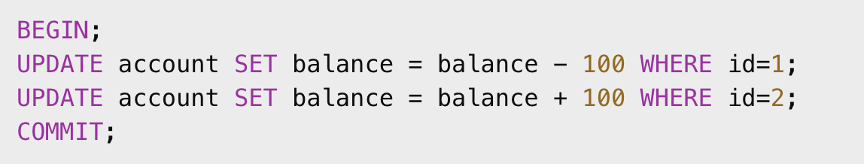
SQL Example
If power fails before COMMIT → changes rolled back.

Slide 61
COMMIT & ROLLBACK
COMMIT saves all changes.
ROLLBACK cancels the transaction.
SAVEPOINT allows partial rollback.

Slide 62
Discussion
Why can’t we rely solely on the application layer to ensure transaction success?

Slide 63
Lecture 1 Recap
Transactions group SQL statements into atomic units.
Concurrency causes anomalies.
ACID ensures correctness and reliability.
COMMIT / ROLLBACK implement control.

Slide 64
Lecture 2 – Concurrency Control & Recovery

Slide 65
Need for Concurrency Control
Goal: allow safe parallel execution without inconsistency.
Approaches:
Locking
Timestamp ordering
  assigns each transaction a unique start time and ensures all operations occur in that same chronological order, so the final outcome matches the order of their timestamps.
Optimistic control
  assumes conflicts between transactions are rare; transactions run without locking, and the system checks for conflicts at commit time, rolling back any that clash.

Slide 66
Locking
A lock prevents others from modifying data being accessed.
Two main types:
Shared Lock (S): read-only, multiple allowed.
Exclusive Lock (X): write, only one allowed.

Slide 67
Lock Granularity
Database-level: simplest, lowest concurrency.
Table-level: moderate concurrency.
Row-level: high concurrency, higher overhead.

Slide 68
Lock Example
T1: UPDATE product SET price=price*1.1 WHERE v_code=21344;
T2: UPDATE product SET qoh=qoh+5 WHERE v_code=21344;
→ Row-level exclusive lock ensures operations happen sequentially.

Slide 69
Deadlocks
When two transactions wait on each other forever.
Example:
T1 locks Table A, waits for Table B.
T2 locks Table B, waits for Table A.
→ Neither can proceed.

Slide 70
Deadlock Solutions
Detection: DBMS checks for cycles and aborts one transaction.
Prevention:
  Order locks consistently.
  Use timeouts.
  Request all resources at once.

Slide 71
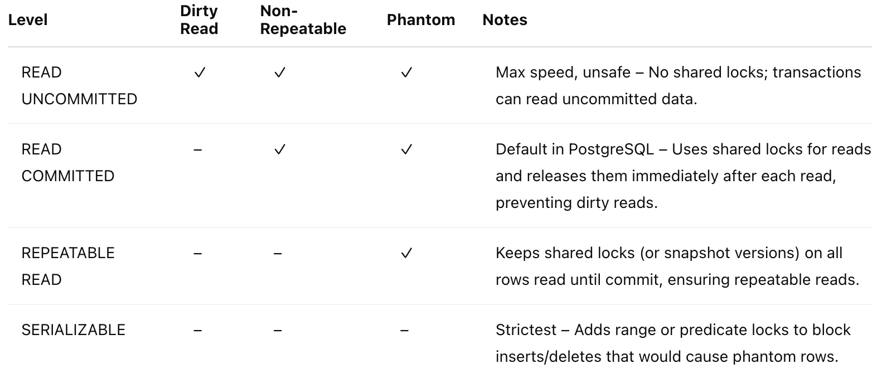
Isolation Levels

Slide 72
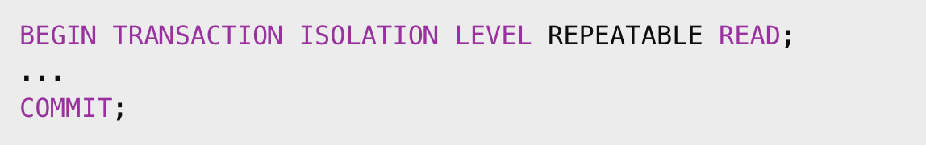
PostgreSQL Example

Slide 73
Scheduling & Serializability
RDBMSs use concurrency control algorithms to schedule concurrent execution of all transaction operations.
DBMS interleaves operations but ensures result = some serial order.
Serializability guarantees logical isolation even when physically concurrent.

Slide 74
Transaction Logs
To recover from failure, DBMS maintains log records for:
Transaction start and end
Each data item change
Before-image and after-image values
Used for undo/redo operations.

Slide 75
Recovery Process
Read log after crash
Identify committed and uncommitted transactions
Redo committed
Undo uncommitted
→ Restore consistent state

Slide 76
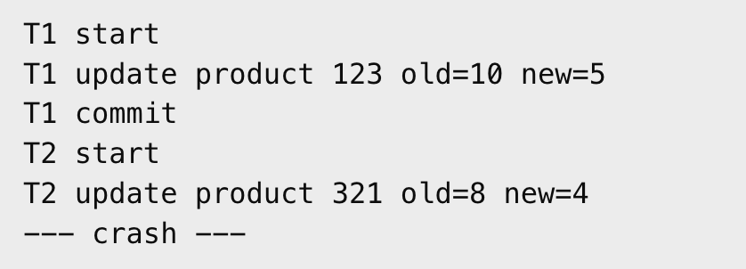
Example: Crash Recovery
Log excerpt:
→ Redo T1, Undo T2.

Slide 77
Checkpoints
Periodic snapshots of current DB + log position.
Simplifies recovery by avoiding reprocessing entire log.
checkpoints are internal to the DBMS and not directly visible or controlled by ordinary users.
only a database administrator can monitor or configure checkpoint behavior (for example, in PostgreSQL via settings like checkpoint_timeout, checkpoint_completion_target, etc.).

Slide 78
Savepoints
Mid-transaction markers.
Let you roll back partially without aborting entire transaction.

Slide 79
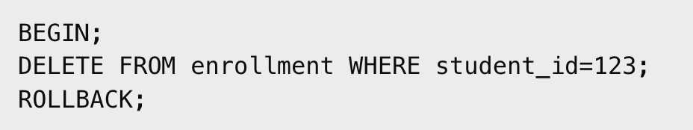
Rollback in PostgreSQL
In psql:
→ verifies that no rows were deleted.

Slide 80
Concurrency Example Discussion
Scenario: Two students try to register for the last seat at once.
Ask: What anomalies could occur without proper locking?
→ Lost updates, double booking.

Slide 81
Best Practices
Always use transactions for multi-statement updates.
Keep transactions short and focused.
Use proper isolation level for workload.
Monitor for deadlocks and long-running transactions.

Slide 82
Summary
Transactions:
Ensure ACID properties
Require locks for concurrency safety
Use logs for recovery
Enable reliable multi-user databases

Slide 83
Reflection Questions
Why does a relational DB need both atomicity and durability?
What could happen if isolation is relaxed too far?
In your project, where might concurrency issues appear?

